Slide 1
Android Development with Kotlin

Slide 2
About this course

Slide 3
Prerequisites
Experience in an object-oriented programming language
Comfortable using an IDE
Familiar with using GitHub
Access to a computer and internet connection
(Optional) Android device and USB cable

Slide 4
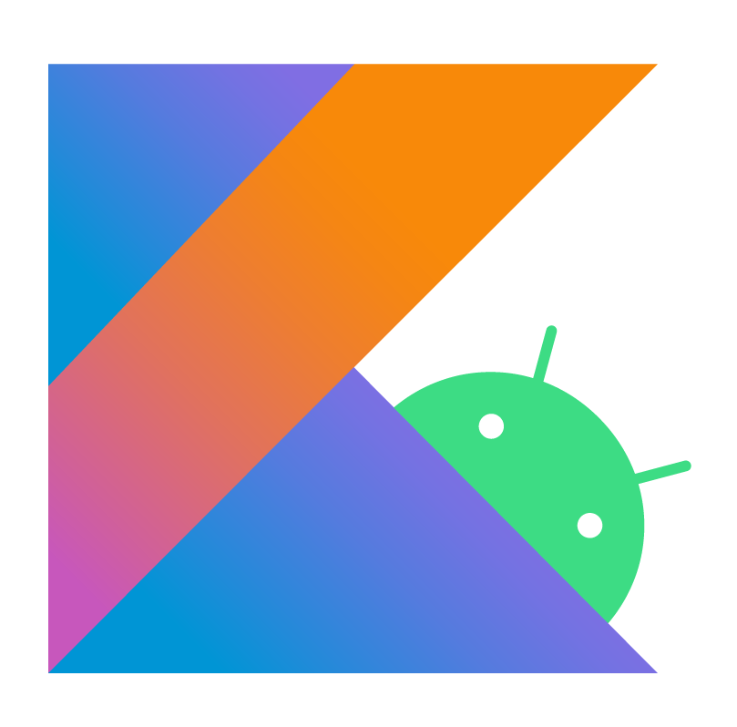
What you'll learn
How to build a variety of Android apps in Kotlin
Kotlin language essentials
Best practices for app development
Resources to keep learning

Slide 5

The opportunity
Mobile devices are becoming increasingly commonplace
Mobile apps connect users to information and services that can improve their quality of life
Many industries have yet to be revolutionized through mobile, and offer great opportunities for new businesses and solutions

Slide 6
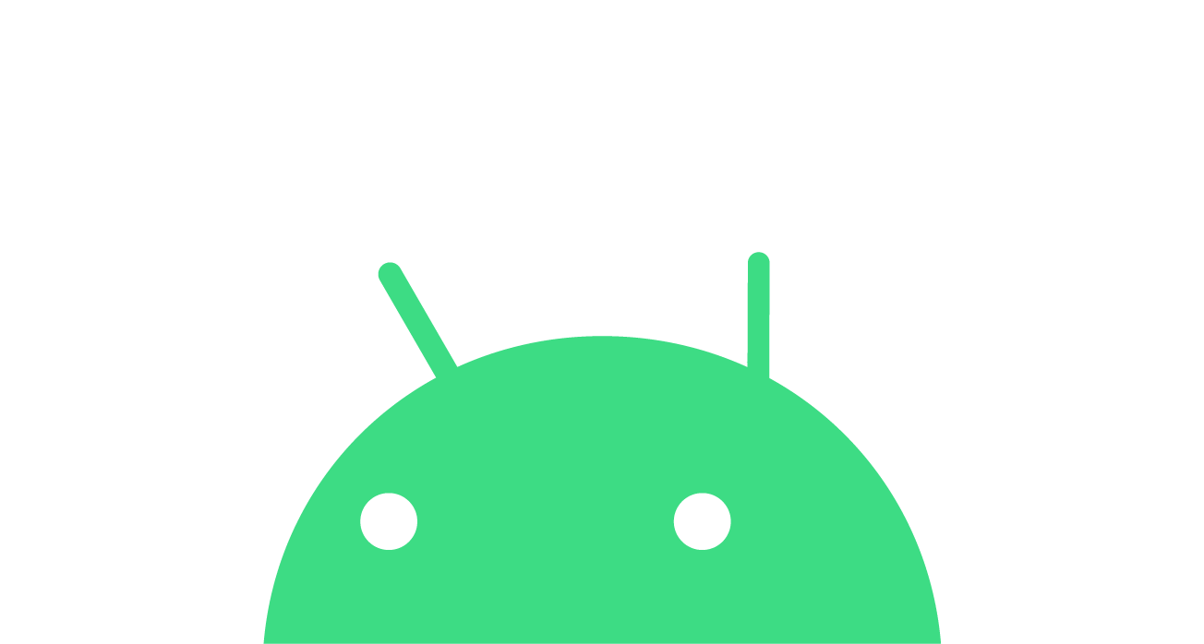
Android
Open-source mobile platform
11 major platform releases so far
2.5 billion monthly active Android devices
2+ billion monthly active Google Play users
Notes:
These statistics are as of August 2020.

Slide 7
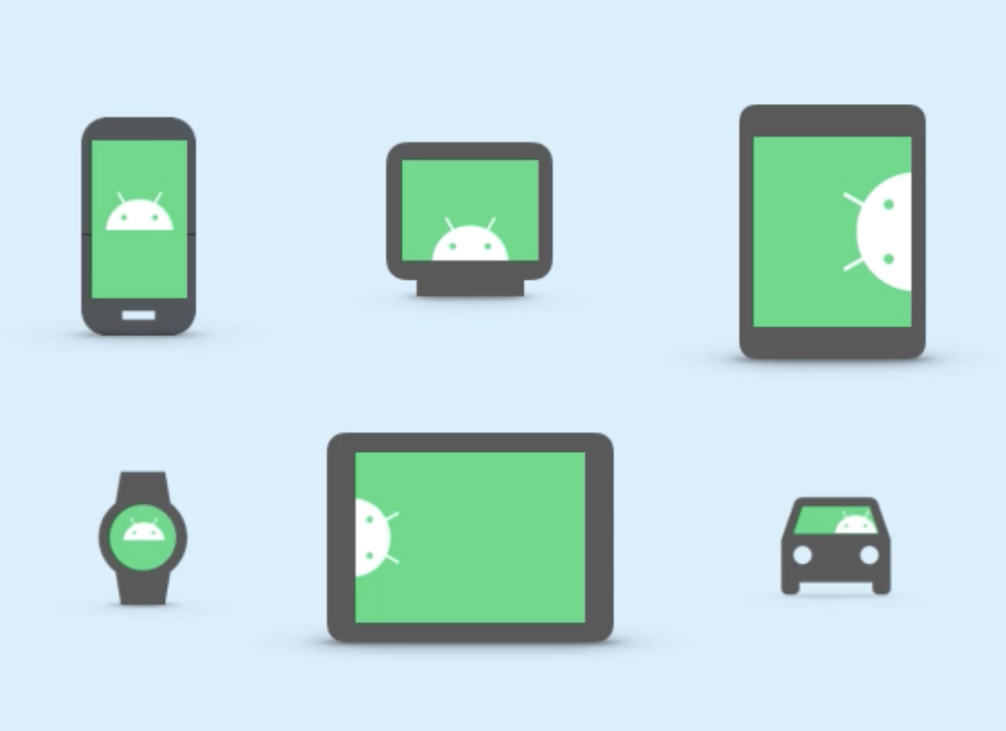
Available across different form factors
Notes:
There are Android phones, tablets, TVs, watches, and even cars.

Slide 8
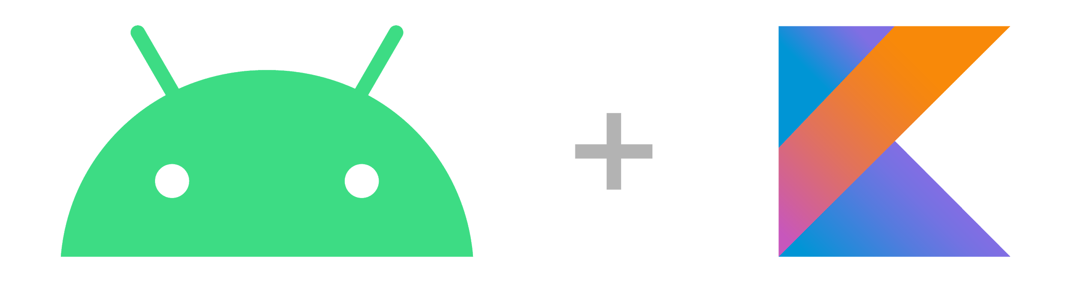
Build Android apps in Kotlin
Notes:
In 2017, Kotlin was officially announced as another supported language on Android.
Two years later, in 2019, Google announced their commitment to making Android development increasingly Kotlin-first. That means new platform features and libraries will first be made available in Kotlin. As a result, new developers are encouraged to build their Android apps in Kotlin.
Together, JetBrains and Google created the Kotlin Foundation to protect, promote, and advance the development of the Kotlin language.
Resources:
Android Announces Support for Kotlin blogpost
Google I/O 2019 blogpost
Kotlin Foundation

Slide 9
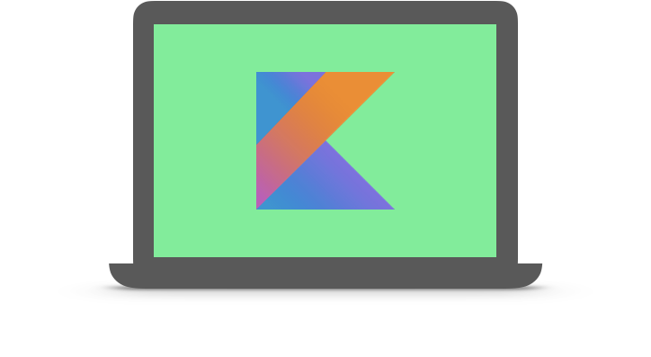
Kotlin
A modern programming language that helps developers be more productive.
Notes:
Kotlin is an open-source statically typed language, which supports both functional programming and object-oriented programming styles. Kotlin was designed to be pragmatic for developers, with a focus on interoperability, safety, clarity, and tooling support.
Kotlin is a modern programming language that has rapidly gained momentum in the industry. According to JetBrains, as of December 2019, there are over 4 million developers globally using Kotlin. Kotlin is currently ranked as the #4 most-loved programming language among developers, according to the 2020 Stack Overflow Developer Survey.
Furthermore, over 60% of professional Android developers use Kotlin, and over 70% of the top 1000 Android apps contain Kotlin code.
Resources:
Kotlin 1.0 released
Kotlin Evolution
Developer Stories

Slide 10
Benefits of Kotlin
Expressive and concise
Safer code
Interoperable
Structured Concurrency
Notes:
Here are some key benefits on why to use Kotlin for Android.
Expressive and concise: With Kotlin, you can express your ideas with less lines of code. There is less boilerplate code. This means development time can be quicker and maintenance is easier. Kotlin also has type inference, so you can omit data types if the Kotlin compiler can infer it, which makes the code more concise.
Safer code: Kotlin also has language features to help you avoid common programming errors. For example, the type system in Kotlin helps you avoid NullPointerExceptions in your code, which can lead to less crashes in an app.
Interoperable: Kotlin is 100% interoperable with the Java programming language. That means you can use existing Java classes and libraries with your Kotlin code. You can add Kotlin to an existing Java project, and there’s even a tool to help you convert Java code into Kotlin code.
Structured Concurrency: With Kotlin coroutines, asynchronous code is as straightforward to work with as blocking code. This simplifies background task management (e.g., for network calls or accessing the database). Using coroutines is the recommended solution for asynchronous programming on Android.
Resources:
Android's Kotlin-first approach
Null Safety
Interoperability
Kotlin coroutines on Android

Slide 11
Idiomatic Kotlin
Kotlin is at its best when used idiomatically
Avoid just translating Java into Kotlin
As you learn more Kotlin, you'll find easier, more concise ways to do things
For a list of common Kotlin idioms, refer to the Kotlin Language Guide on Idioms
Notes:
Resource:
Idioms

Slide 12
Learning experience

Slide 13
Course structure
4 units with a total of 13 lessons across 13 weeks
Unit 1(3 weeks)
Unit 2 (3 weeks)
Unit 3 (6 weeks)
Unit 4 (1 week)
Get Started with Kotlin
Basics, Functions, Classes & Objects, Extensions
Introduction to Android
First App, Layouts, Navigation
Android App Architecture
App Architecture, Data Persistence, Display Lists, Connect to Internet, Background Work
App Design
App UI Design
Notes:
To build Android apps in Kotlin, we will first focus on learning the essentials of the Kotlin programming language. We’ll cover a range of basic Kotlin language features in the first 3 weeks of the course. Once you become familiar with Kotlin, you will learn about Android development for the remaining 10 weeks of the course.
Note to instructors:
The schedule is for a proposed 13-week curriculum, which can be adjusted to be longer or shorter depending on semester length at your university, and the material you’d like to cover.

Slide 14
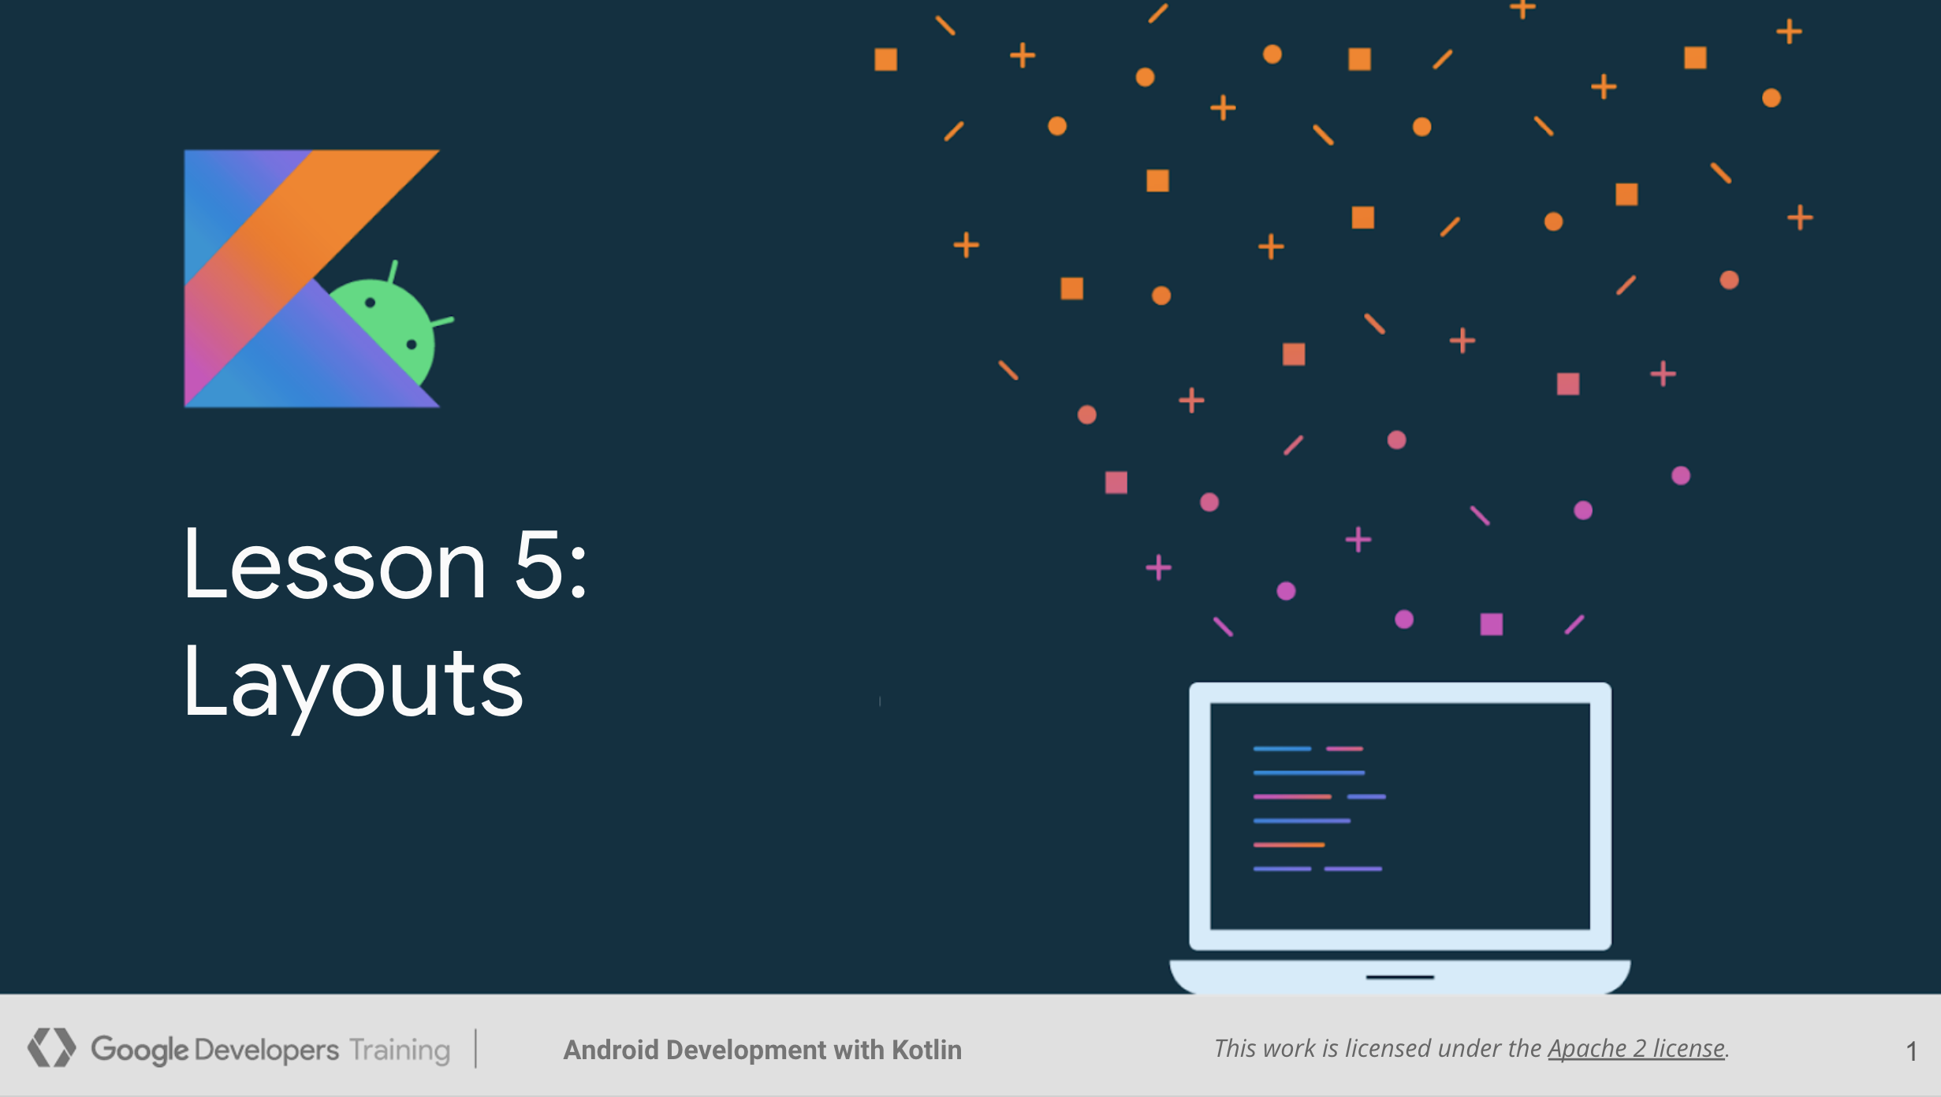
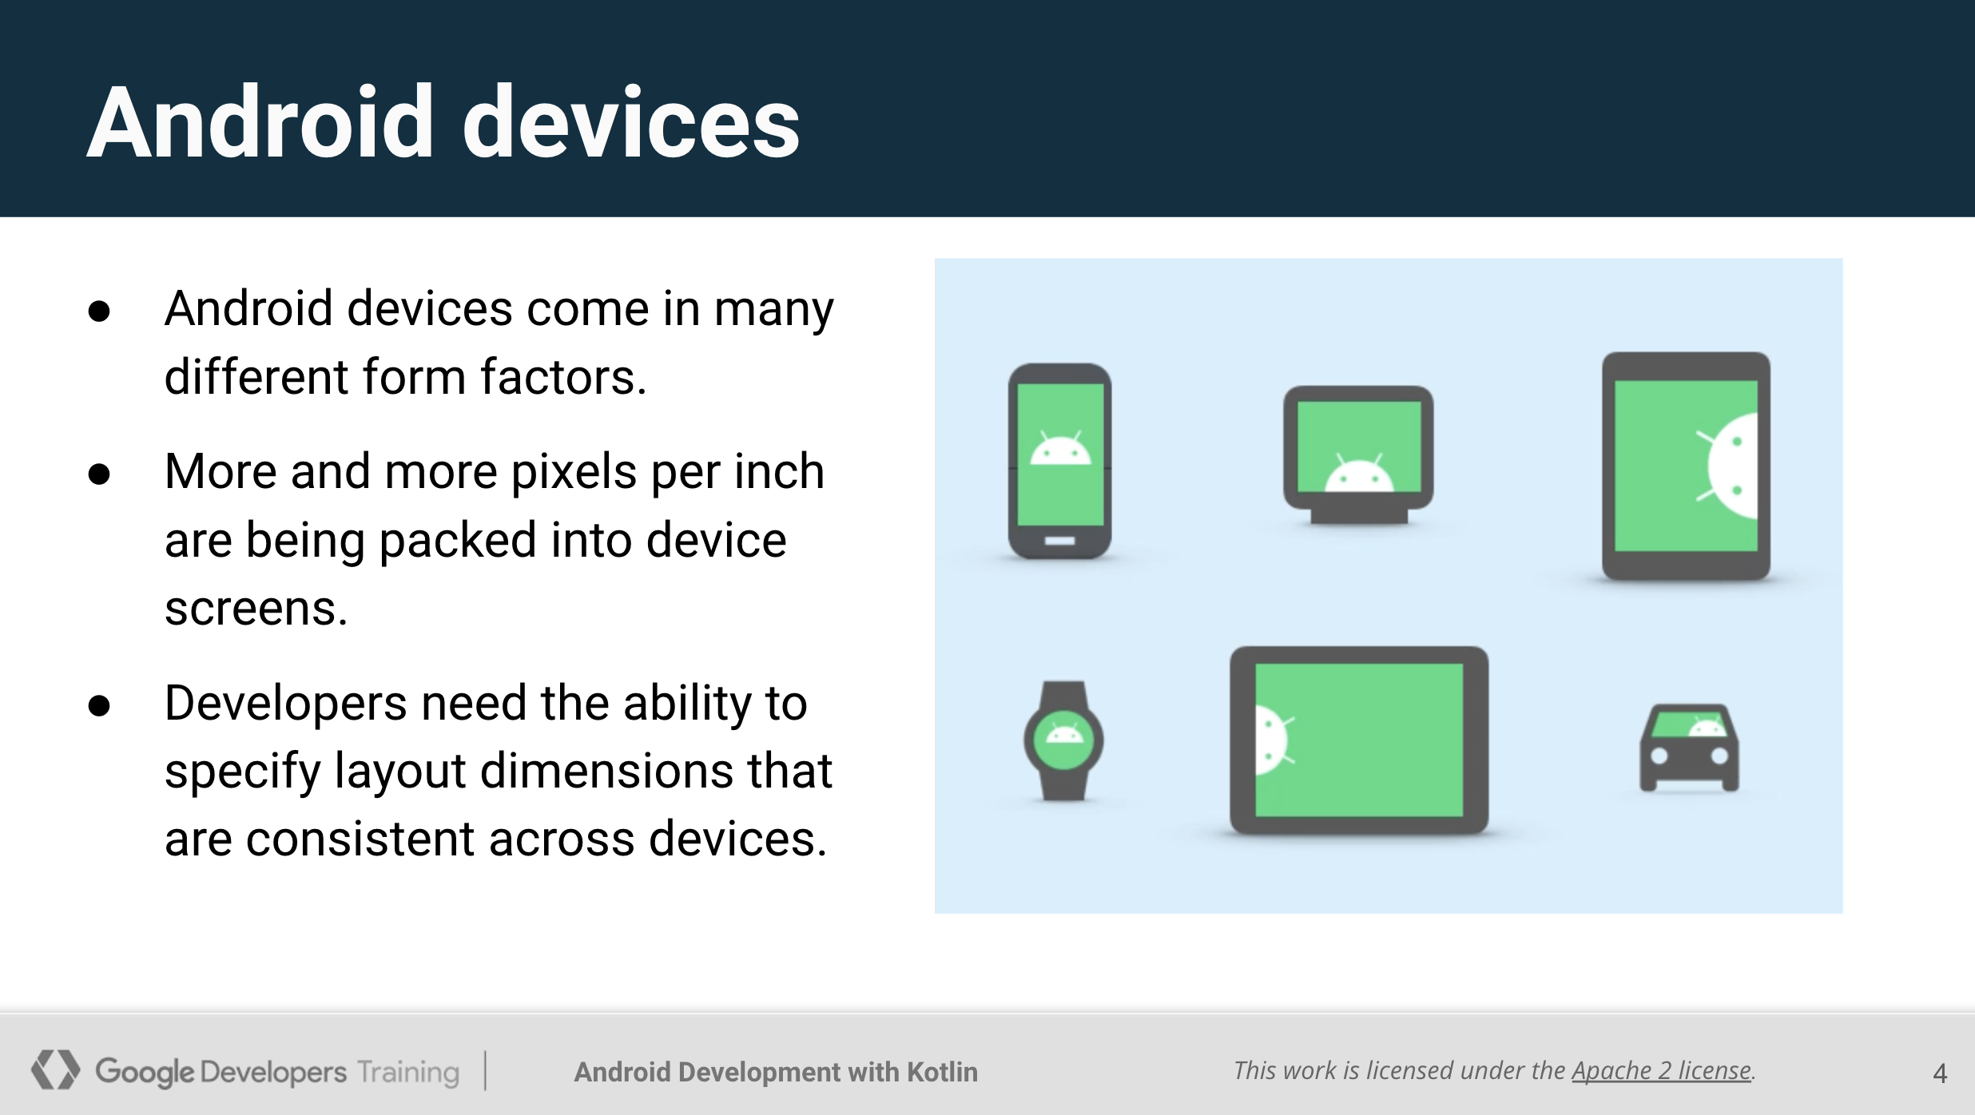
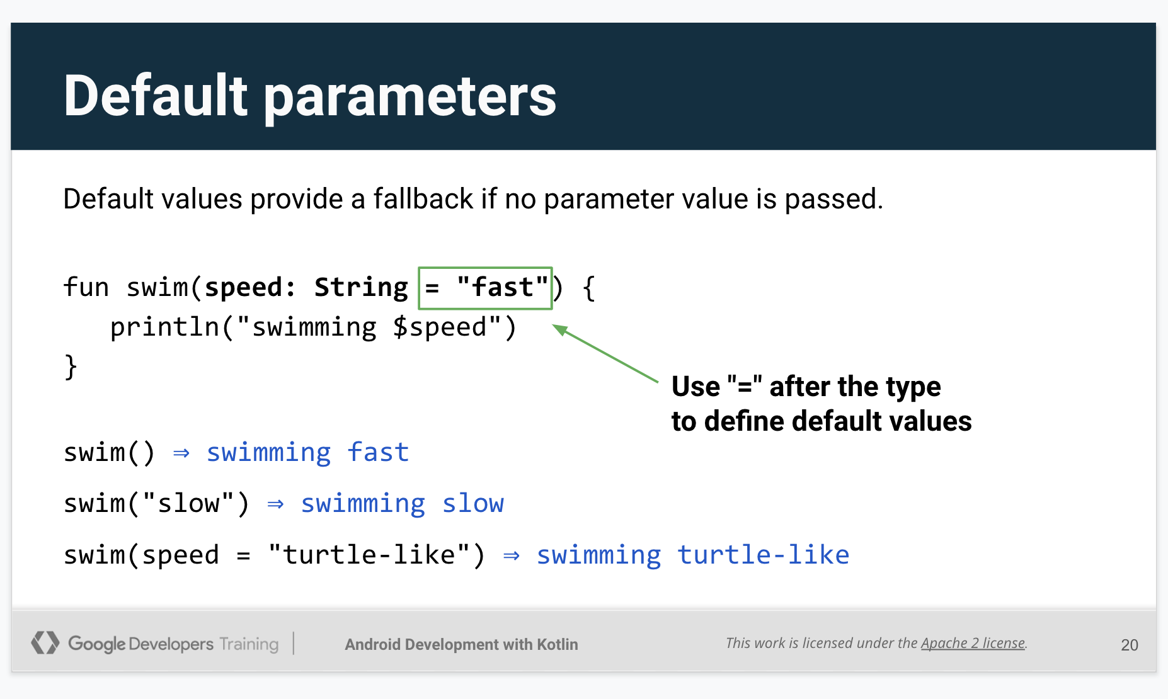
Lectures
We’ll cover important topics together as a class.
Notes:
During class, we’ll be going over important Kotlin and Android topics for each lesson.

Slide 15
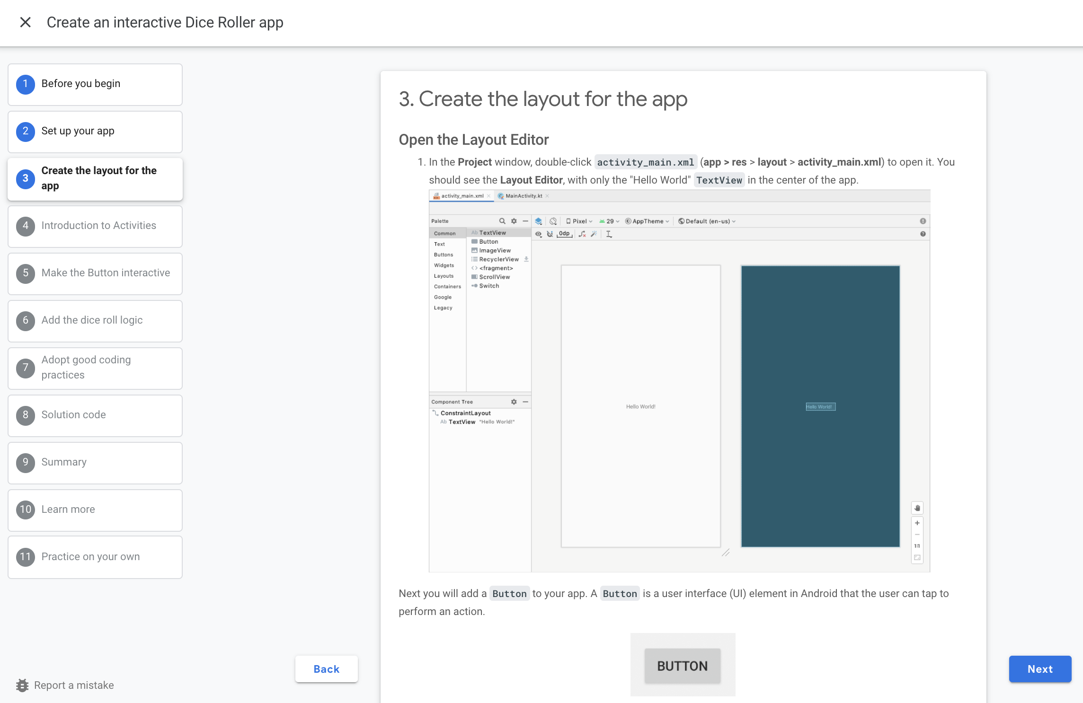
Learning pathways
After each class, complete the corresponding learning pathway with articles and codelabs to practice what you learned.
Notes:
While there is a lot of content to cover, the important thing to remember is that you’ll get hands-on practice via learning pathways to apply what you learned.
After each class, you’ll get a link to a learning pathway for you to complete on your own. After you complete the learning activities within the pathway, be sure to complete the quiz to earn a badge.

Slide 16

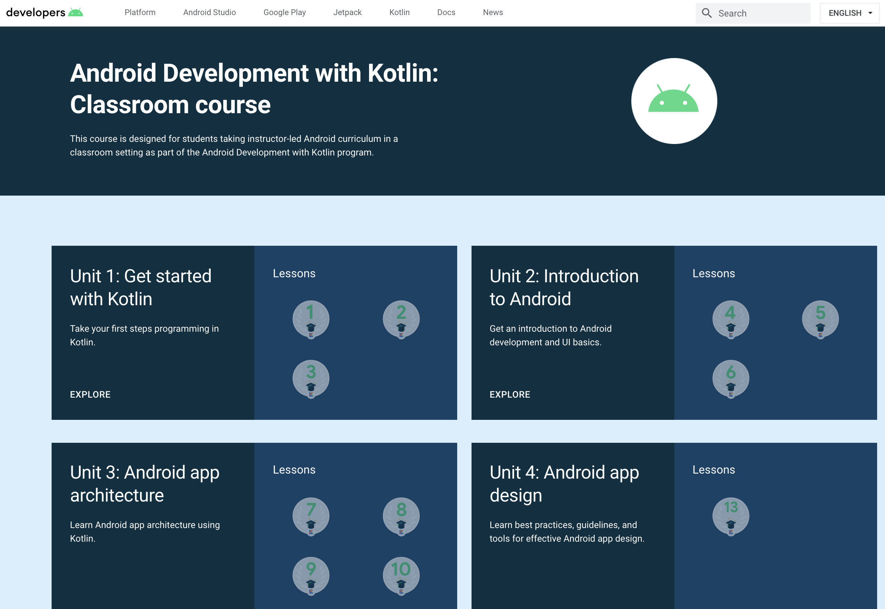
Accessing the pathways
Notes:
This is how you will access the course on the Android Developers website and the pathways within them
https://developer.android.com/courses/android-development-with-kotlin/course

Slide 17
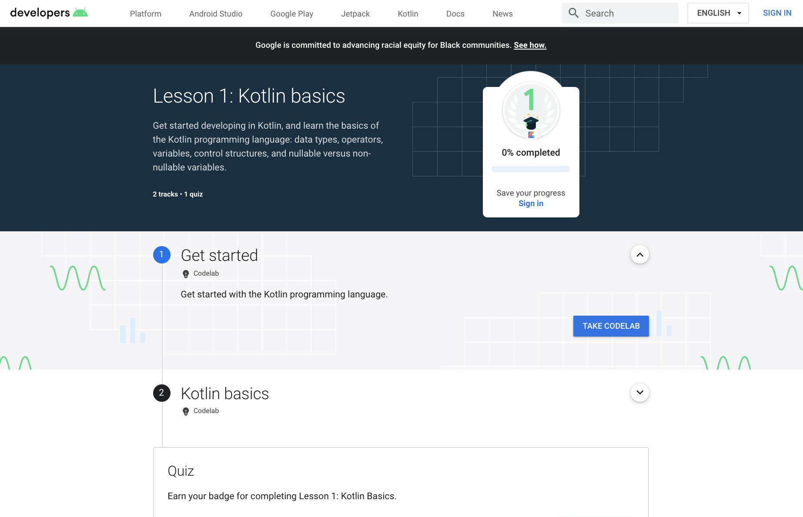
Pathway
Notes:
What is a pathway? It’s an ordered sequence of activities to learn a specific skill. An activity can be a video, hands-on coding tutorial (known as a codelab), an article, or a quiz. You can see three activities in this first pathway. All of these activities are meant to help you reach specific learning objectives by the end of this pathway.

Slide 18
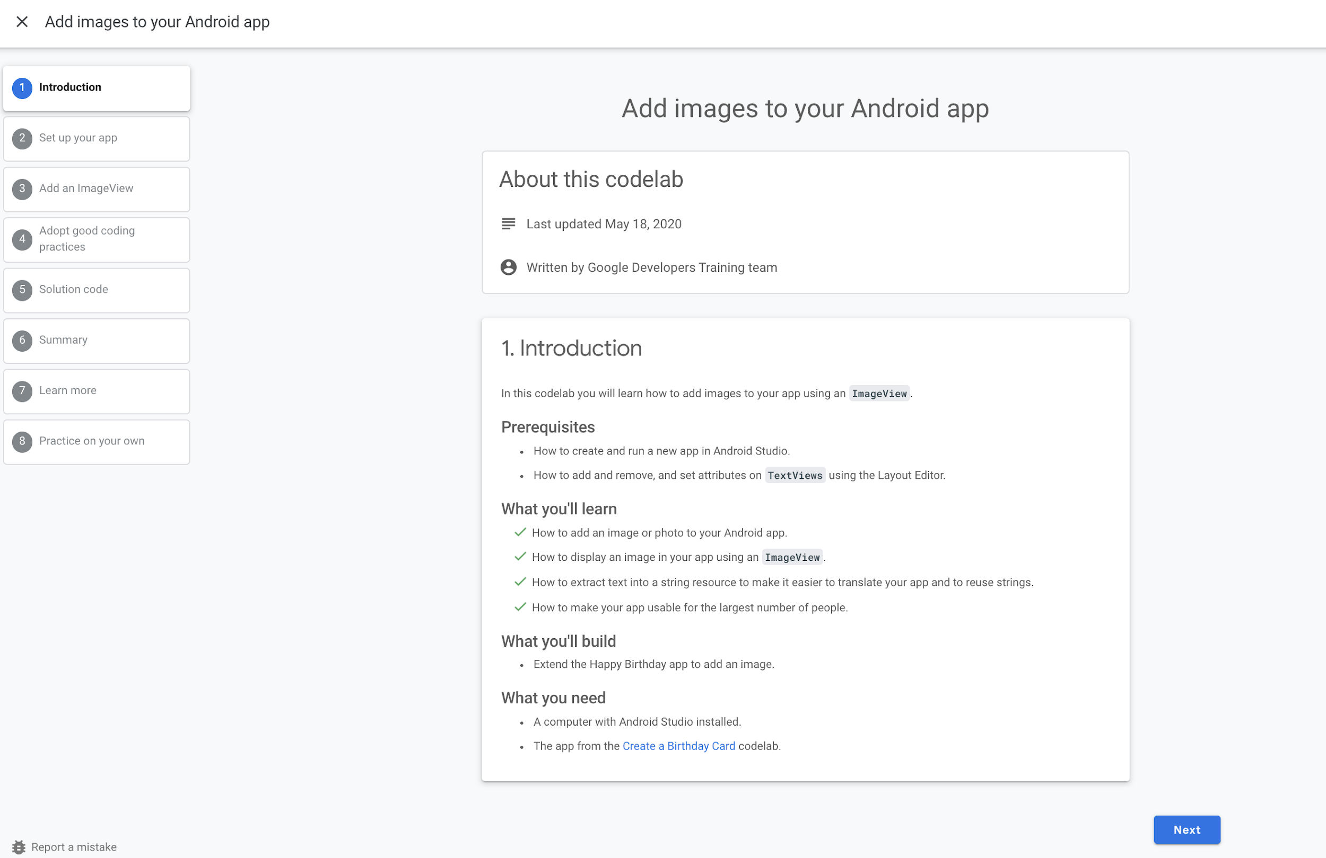
Codelab
Notes:
What is a codelab? It’s a hands-on coding tutorial that provides practical instructions for implementing the concepts presented in the preceding lecture.

Slide 19
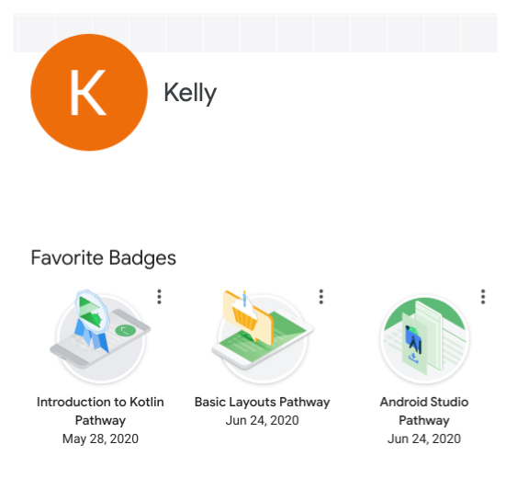

Earn badges for your developer profile
Notes:
At the end of each pathway, there is a quiz to test what you have learned so far. Once you complete the quiz, you earn a badge that can be saved to your Google Developer Profile. Access your profile directly using google.dev/u/me.

Slide 20
What you need
To work through the Kotlin and Android examples in the Android Development with Kotlin labs you'll need to install the following software on your computer:
Java Development Kit
Java Runtime Engine (Windows only)
IntelliJ IDEA
Android Studio
https://play.kotlinlang.org/
Notes:
You'll need to install IntelliJ IDEA to be able to use Kotlin REPL (Read-Eval-Print-Loop) and to run Kotlin programs.

Slide 21
Resources

Slide 22
Kotlin resources
Learn Kotlin for a list of official reference materials
Kotlin Language Documentation (downloadable PDF)
Kotlin Koans for more snippets to practice with
Coding Conventions for a coding style guide for the Kotlin language
Learn Kotlin by Example for a set of small and simple annotated examples

Slide 23
Android and other resources
Official Android developer website
Android Developers Blog
Android Developers Medium blog
Android Developers YouTube channel
@AndroidDev on Twitter
Android Developer Newsletter
Stack Overflow
Offline documentation through SDK Manager

